Slide 1
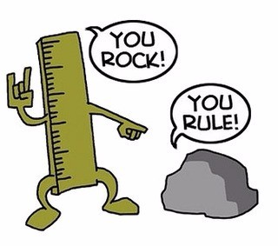
This weeks

Slide 2
Year 7 & 8 Middle and Upper Band
Year 7 & 8 Fast Track
Year 7 & 8 High Achievers
Year 9 & 10 Middle and Upper Band
Year 9 & 10 Fast Track
Year 9 & 10 High Achievers

Slide 3
Year 7 & 8 Middle and Upper Band
Debt Recovery
Tony owes Tina 40p.
Then Tina borrows 50p from Tony.
Later Tony gives Tina 60p.
Who has to pay what to whom to square things up?
Notes:
ANSWER
Tina gives Tony 70p. Let x be the amount Tony owes Tina (which will be negative if Tina owes Tony). Tony owes Tina 40p: x=40 . Tina borrows 50p from Tony: x=−10 Tony gives Tina 60p: x=−70 . So Tina owes Tony 70p.

Slide 4
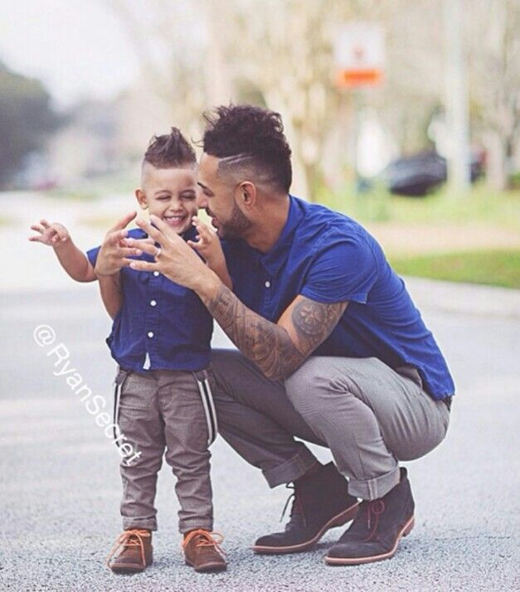
Year 7 & 8 Fast track
Reverse Ages
On his 14th birthday, Brian's father was 41. Brian noticed that his age was the reverse of his father's age. How old will Brian be the next time his age is the reverse of his father's age?
Notes:
ANSWER
Working it out by thinking about the numbers While Brian is still a teenager, his age can only be the reverse of his father's age if his father's age ends in 1. But that won't happen again until Brian's father is 51, which is 10 years away - and Brian will be 24 by then, not a teenager any more. While Brian is in his twenties, his age can only be the reverse of his father's age if his father's age ends in 2. That will happen when Brian's father is 42, which is 1 year away - so Brian will only be 15 by then, which is not the reverse of 42. It will happen again when Brian's father is 52, which is 11 years away - so Brian will be 14 + 11 = 25 by then, which is the reverse of 52. So the next time that Brian's age is the reverse of his father's age, Brian will be 25.

Slide 5
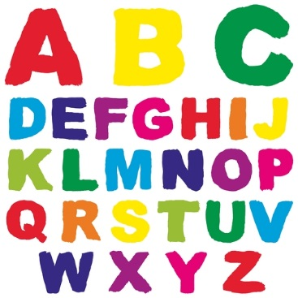
Year 7 & 8 High Achievers
Alphabetical Angle
There are 120 different arrangements of the five letters in the word ANGLE.
If all 120 are listed in alphabetical order starting with AEGLN and finishing with NLGEA, which position in the list does ANGLE occupy?
Notes:
ANSWER
There are 24 arrangements of the letters in the word ANGLE with A as the first letter (the number of ways of arranging the other 4 letters is 4×3×2×1 ). In alphabetical order AEGLN is first and ANLGE is last. ANLEG is the 23rd and hence ANGLE is in the 22nd position on the list.

Slide 6
Year 9 & 10 Middle and Upper Band
Reverse Ages
On his 14th birthday, Brian's father was 41. Brian noticed that his age was the reverse of his father's age. How old will Brian be the next time his age is the reverse of his father's age?
Notes:
ANSWER
Working it out by thinking about the numbers While Brian is still a teenager, his age can only be the reverse of his father's age if his father's age ends in 1. But that won't happen again until Brian's father is 51, which is 10 years away - and Brian will be 24 by then, not a teenager any more. While Brian is in his twenties, his age can only be the reverse of his father's age if his father's age ends in 2. That will happen when Brian's father is 42, which is 1 year away - so Brian will only be 15 by then, which is not the reverse of 42. It will happen again when Brian's father is 52, which is 11 years away - so Brian will be 14 + 11 = 25 by then, which is the reverse of 52. So the next time that Brian's age is the reverse of his father's age, Brian will be 25.

Slide 7
Year 9 & 10 Fast Track
Notes:
ANSWER
There are 24 arrangements of the letters in the word ANGLE with A as the first letter (the number of ways of arranging the other 4 letters is 4×3×2×1 ). In alphabetical order AEGLN is first and ANLGE is last. ANLEG is the 23rd and hence ANGLE is in the 22nd position on the list.

Slide 8
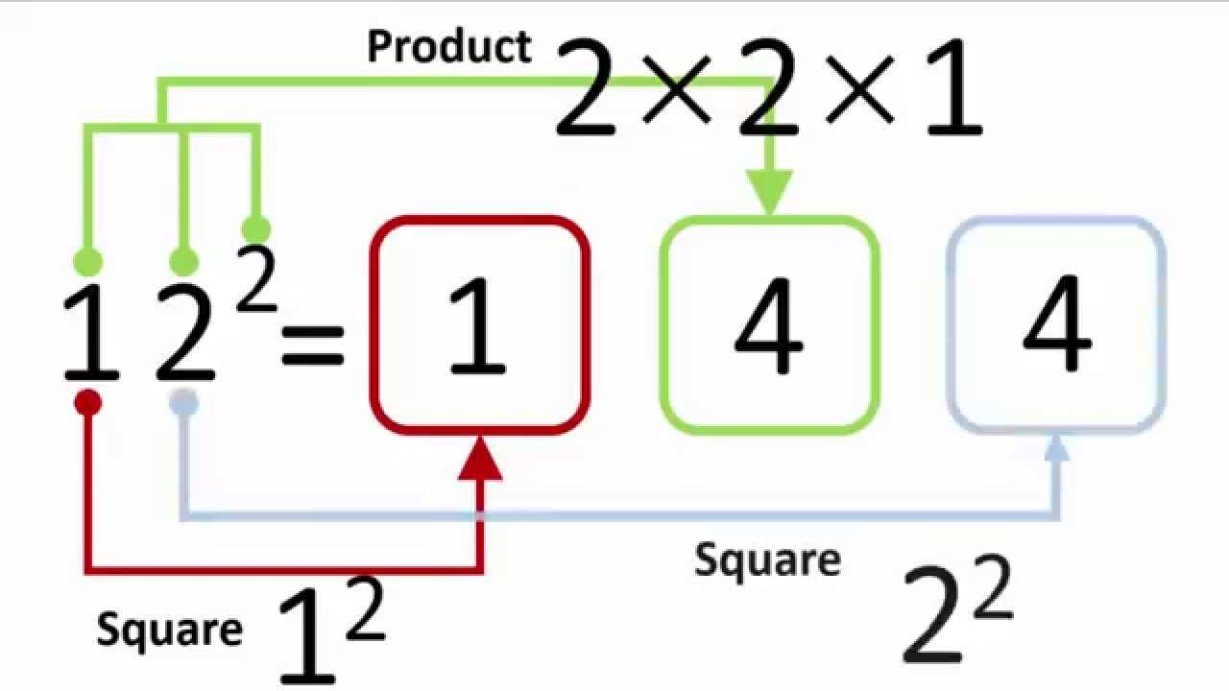
Year 9 & 10 High Achievers
2-Digit Square
A 2-digit number is squared. When the 2-digit number is reversed and squared, the difference between the squares is also a square.
What is the 2-digit number?
Notes:
ANSWER:
Thank you Abdul for this solution. The 2-digit number is either 65 or 56 .
Proof:
Any 2-digit number can be represented as 10a+b . We need (10a+b)2−(10b+a)2=99a2−99b2=9×11×(a2−b2) to be a square.
This means that (a2−b2) must be 11 and so (a−b)(a+b)=11 making, a−b=1 and a+b=11 . This gives a=6 , and b=5 .
If we find a solution with a>b then, by reversing the digits, we get a second solution.

