Slide 1
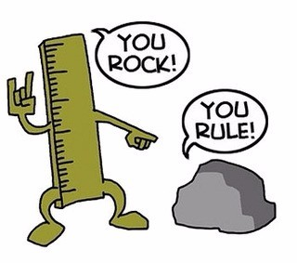
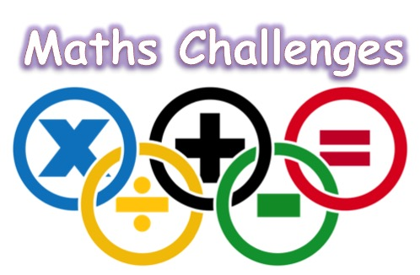
This weeks

Slide 2
Year 7 & 8 Middle and Upper Band
Year 7 & 8 Fast Track
Year 7 & 8 High Achievers
Year 9 & 10 Middle and Upper Band
Year 9 & 10 Fast Track
Year 9 & 10 High Achievers

Slide 3
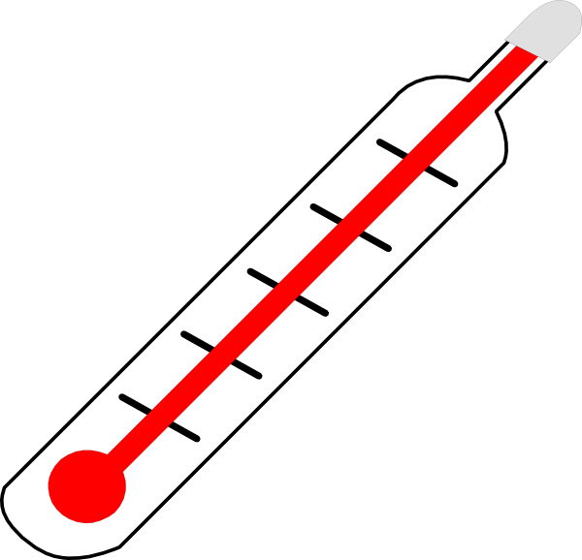
Year 7 & 8 Middle and Upper Band
Highs and Lows
I have a max/min thermometer in my greenhouse. It records both the highest and the lowest temperatures reached since the time I reset it.
I reset it on Sunday when the temperature was 4∘C.
Overnight the temperature fell 5∘.
Then during Monday it rose by 6∘ before falling 10∘ during the night.
On Tuesday it rose by 4∘ and fell by 2∘ overnight.
On Wednesday morning, what were the maximum and minimum temperatures
Notes:
ANSWER
Sunday Max 4⁰ Min -1⁰
Monday Max 5⁰ Min -5⁰
Tuesday Ma -1⁰ Min -3⁰
So on Wednesday morning the Maximum recorded temperature is 5∘
and the Minimum−5∘

Slide 4
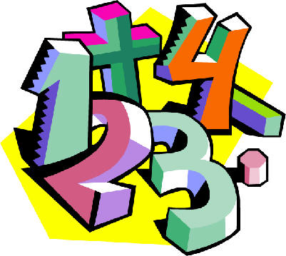
Year 7 & 8 Fast track
Central Sum
In how many whole numbers between 100 and 999 is the middle digit equal to the sum of the other two digits?
Notes:
ANSWER
Consider numbers whose first digit is 1. Looking at each possible value for the second digit we find 9 such numbers.
110, 121, 132, 143, 154, 165, 176, 187, 198.
Similarly there are 8 numbers starting with 2; 7 numbers starting with 3...
Lastly there is only one number starting with 9: 990.
Hence the total is 9+8+7+6+5+4+3+2+1 = 45.

Slide 5
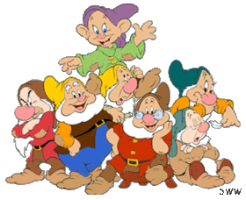
Year 7 & 8 High Achievers
Dopey Measurement
Snow White wanted to know the mean height of the Seven Dwarfs. So one day she measured them all as they left for work and calculated their mean height as 112.3 cm. Doc complained that she had left him out and measured Dopey twice without him noticing. If Doc is 3 cm taller than Dopey, what is the mean height of the Seven Dwarfs (correct to one decimal place)
Notes:
ANSWER
112.7 cm. In order to calculate the mean height, Snow White had to first calculate the sum of the heights of the Dwarves (S ), and then divide by 7. Her value for S was too small by 3 cm, so her value for the mean was too small by 3/7≈0.4 cm. So the actual mean height is 112.3+0.4=112.7 cm.

Slide 6
Year 9 & 10 Middle and Upper Band
Central Sum
In how many whole numbers between 100 and 999 is the middle digit equal to the sum of the other two digits?
Notes:
ANSWER
Consider numbers whose first digit is 1. Looking at each possible value for the second digit we find 9 such numbers.
110, 121, 132, 143, 154, 165, 176, 187, 198.
Similarly there are 8 numbers starting with 2; 7 numbers starting with 3...
Lastly there is only one number starting with 9: 990.
Hence the total is 9+8+7+6+5+4+3+2+1 = 45.

Slide 7
Year 9 & 10 Fast Track
Dopey Measurement
Snow White wanted to know the mean height of the Seven Dwarfs. So one day she measured them all as they left for work and calculated their mean height as 112.3 cm. Doc complained that she had left him out and measured Dopey twice without him noticing. If Doc is 3 cm taller than Dopey, what is the mean height of the Seven Dwarfs (correct to one decimal place)?
Notes:
ANSWER
112.7 cm. In order to calculate the mean height, Snow White had to first calculate the sum of the heights of the Dwarves (S ), and then divide by 7. Her value for S was too small by 3 cm, so her value for the mean was too small by 3/7≈0.4 cm. So the actual mean height is 112.3+0.4=112.7 cm.

Slide 8
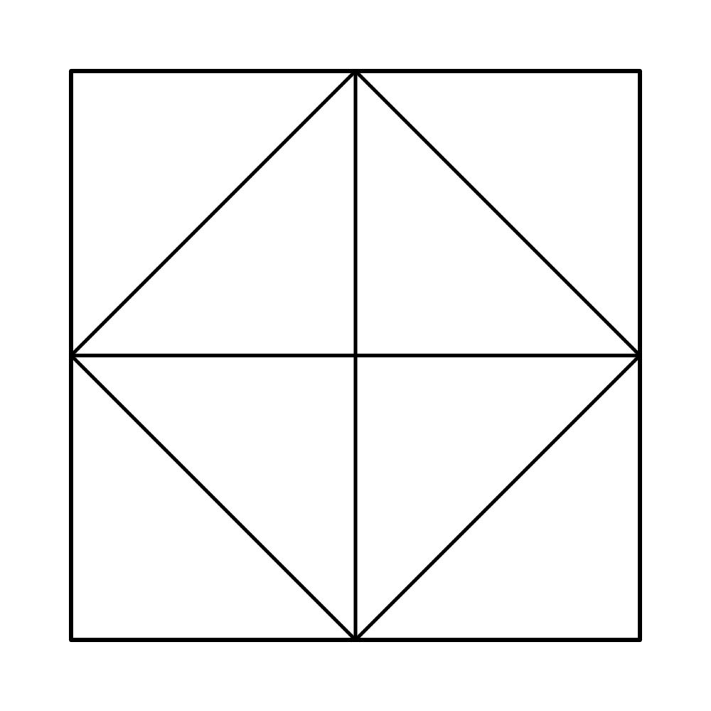
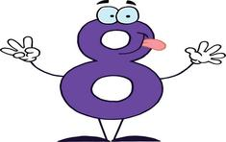
Year 9 & 10 High Achievers
Pieces of Eight
A square is divided into eight congruent triangles, as shown.
Two of these triangles are selected at random and shaded black. What is the probability that the resulting figure has at least one axis of symmetry?
Notes:
ANSWER:
If the first triangle selected to be shaded is a corner triangle, then the final figure will have at least on axis of symmetry provided that the second triangle selected is one of five triangles. For example, if A is chosen first then there will be at least one axis of symmetry in the final figure if the second triangle selected is B, D, E, G or H. The same applies if an inner triangle is selected first: for example, if B is chosen first then there will be at least one axis of symmetry in the final figure if the second triangle selected is A, C, F, G or H. So, the probability that the final figure has at least one axis of symmetry is 5/7
ALSO SEE IMAGE ON SLIDE 9

Slide 9
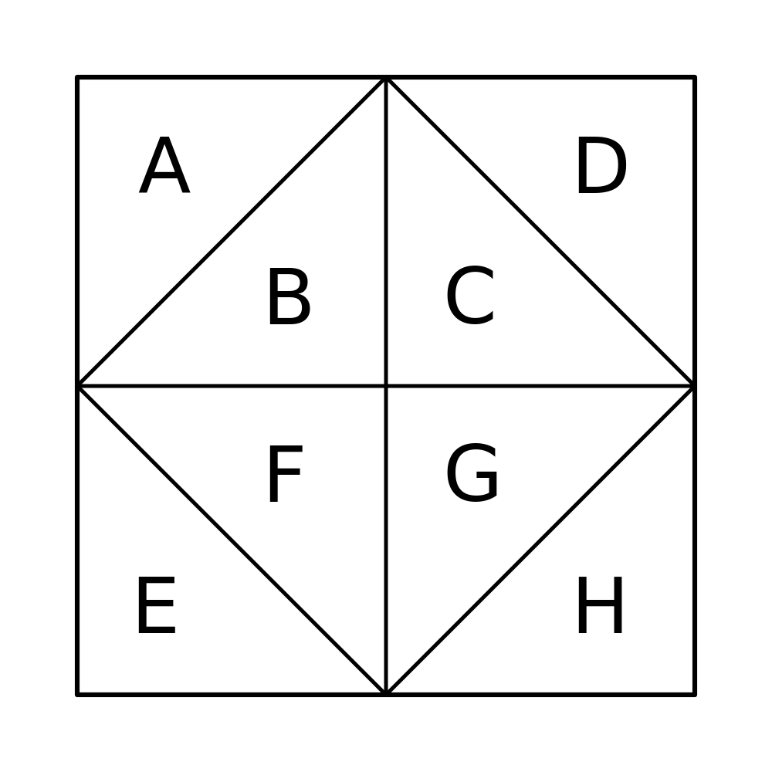
Image to assist with the answer to Pieces of Eight

