Slide 1
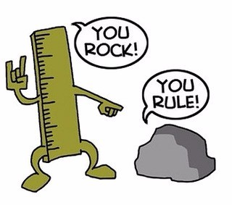
This weeks

Slide 2
Year 7 & 8 Middle and Upper Band
Year 7 & 8 Fast Track
Year 7 & 8 High Achievers
Year 9 & 10 Middle and Upper Band
Year 9 & 10 Fast Track
Year 9 & 10 High Achievers

Slide 3
Year 7 & 8 Middle and Upper Band
Number Daisy
This Daisy is special because you can make every number from 1 to 25. You are only allowed to add neighbours (numbers touching each other) and you can only use each number once in a sum.
Example: To make 18 = 7+5+4+2
Notes:
ANSWER
1 = 1 2 = 2 3 = 1 + 2 4 = 4 5 = 5 6 = 2 + 4 7 = 1 + 2 + 4 8 = 5 + 1 + 2 9 = 4 + 5 10 = 7 + 1 + 2 11 = 5 + 4 + 2 12 = 5 + 4 + 2 + 1 13 = 7 + 6 14 = 7 + 6 + 1 15 = 7 + 6 + 2 16 = 7 + 6 + 2 + 1 17 = 7 + 5 + 4 + 1 18 = 7 + 5 + 4 + 2 19 = 7 + 5 + 4 + 2 + 1 20 = 5 + 7 + 6 + 2 21 = 5 + 7 + 6 + 2 + 1 22 = 4 + 5 + 7 + 6 23 = 5 + 7 + 6 + 1 + 4 24 = 5 + 7 + 6 + 2 + 4 25 = 5 + 7 + 6 + 2 + 4 + 1

Slide 4
Year 7 & 8 Fast track
Wipeout
Take the numbers 1,2,3,4,5,6 and choose one to wipe out.
For example, you might wipe out 5, leaving you with 1,2,3,4, 6.
The mean of what is left is 3.2.
I wonder whether I can wipe out one number from 1 to 6, and leave behind an average which is a whole number...
EXTENSION: One of the numbers from 1 to 15 is wiped out.
The mean of what is left is 7.714285714. Which number was crossed out?
Notes:
ANSWER
To work out the mean we add together all of the numbers, then divide by the total number of digits. (1+2+3+4+6)/5 = 3.2
Remove 1 = Mean is 4
Remove 6 = Mean is 3
EXTENSION = 12 was crossed out

Slide 5
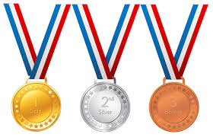
Year 7 & 8 High Achievers
Medal Ceremony
6 pupils have, between them, won three gold medals, two silver medals and a bronze medal in a painting competition. Unfortunately, their teacher has lost all record of which medals should go to which pupils, so he allocates them by drawing names out of a hat. The first 3 names drawn receive the gold medals, the next two drawn have the silver medals, and the bronze medal goes to the remaining pupil. How many different ways can the medals be allocated by this method?
Notes:
ANSWER
There are 6 different students who could receive the first gold medal, then 5 others for the second and 4 remaining for the third. Therefore there are 6×5×4=120 orders in which the medals can be presented. However, this counts each set of three people winning the medals in each of the six orders, so there are 120÷6=20 sets of three people who could win gold. For each of these, one of the remaining three people must win bronze and the others silver, so there are 20×3=60 ways in which the medals can be awarded.

Slide 6
Year 9 & 10 Middle and Upper Band
Wipeout
Take the numbers 1,2,3,4,5,6 and choose one to wipe out.
For example, you might wipe out 5, leaving you with 1,2,3,4, 6.
The mean of what is left is 3.2.
I wonder whether I can wipe out one number from 1 to 6, and leave behind an average which is a whole number...
EXTENSION: One of the numbers from 1 to 15 is wiped out.
The mean of what is left is 7.714285714. Which number was crossed out?
Notes:
ANSWER
To work out the mean we add together all of the numbers, then divide by the total number of digits. (1+2+3+4+6)/5 = 3.2
Remove 1 = Mean is 4
Remove 6 = Mean is 3
EXTENSION = 12 was crossed out

Slide 7
Year 9 & 10 Fast Track
Medal Ceremony
6 pupils have, between them, won three gold medals, two silver medals and a bronze medal in a painting competition. Unfortunately, their teacher has lost all record of which medals should go to which pupils, so he allocates them by drawing names out of a hat. The first 3 names drawn receive the gold medals, the next two drawn have the silver medals, and the bronze medal goes to the remaining pupil. How many different ways can the medals be allocated by this method?
Notes:
ANSWER
There are 6 different students who could receive the first gold medal, then 5 others for the second and 4 remaining for the third. Therefore there are 6×5×4=120 orders in which the medals can be presented. However, this counts each set of three people winning the medals in each of the six orders, so there are 120÷6=20 sets of three people who could win gold. For each of these, one of the remaining three people must win bronze and the others silver, so there are 20×3=60 ways in which the medals can be awarded.

Slide 8
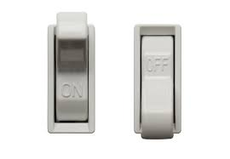
Year 9 & 10 High Achievers
Switch On
In how many different ways can a row of five "on/off" switches be set so that no two adjacent switches are in the "off" position?
Notes:
ANSWER:
Clearly there must be at least two "on" switches. If there are two "on" switches and three "off" switches then they can only be set in one way: "off","on","off","on","off". Suppose there are three "on" switches and two "off" switches. Let's decide on the position of the "off" switches first and then fill in the gaps with the "on" switches. We can put the "off" switches in the following places: Positions 1 and 3 , Positions 1 and 4 , Positions 1 and 5 , Positions 2 and 4 , Positions 2 and 5 , Positions 3 and 5 . Therefore there are six ways to arrange three "on" switches and two "off" switches. Suppose there are four "on" switches and one "off" switch. The "off" switch can be put in any position, so there are five possible ways to arrange these. If there are five "on" switches there is exactly one way we can arrange these. Therefore the total number of ways is 1+6+5+1=13 .

